Slide 1


Predicting Maintenance Failures
Sadie Harper
DSC680-T301 Applied Data Science (2231-1)

Slide 2
AGENDA
01 | Background
02 | Data Details
03 | Challenges
04 | Models
05 | Results
06 | Conclusion

Slide 3
Background
Problem
Why is this important?
Maintenance failures can occur within many industries
Unexpected maintenance is costly
Predictive maintenance can improve all areas of a maintenance pipeline
Higher customer satisfaction
Savings on time & money

Slide 4
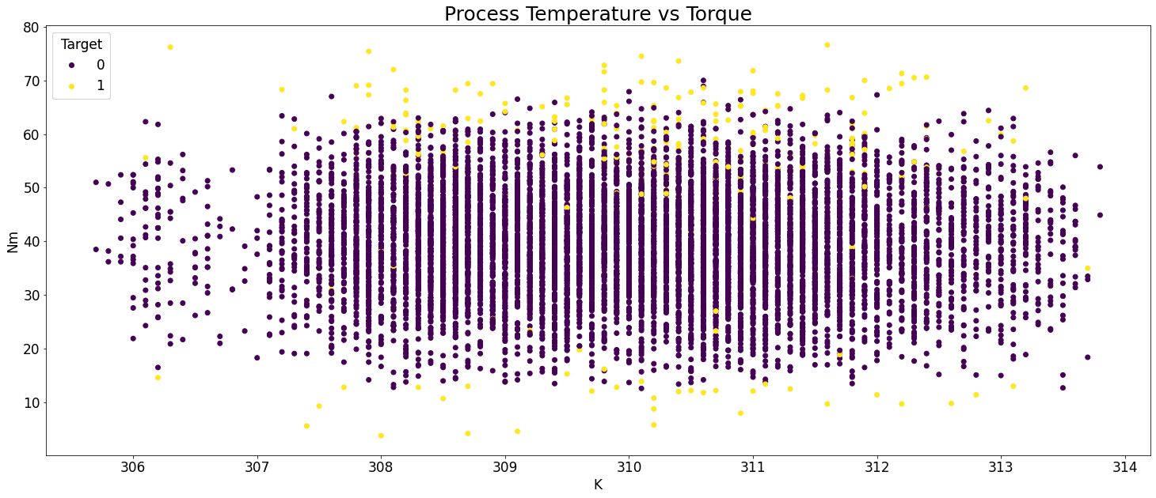
Data Details
10,000 observations of synthetic maintenance data
10 features
Target: Failure (1) | Non-Failure (0)

Slide 5
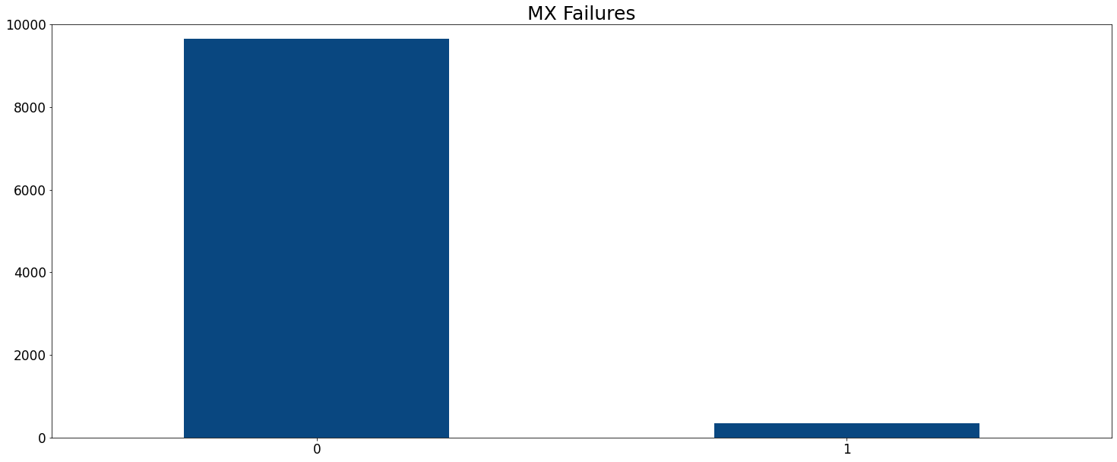
Challenges
Data imbalance
Data size
Improving the right metrics

Slide 6
Models
Supervised binary classification
Important metrics:
F1 Score
Recall
Precision
Model | Accuracy | F1 Score | Recall | Precision
K-Neighbors Classifier | 0.896 | 0.895 | 0.896 | 0.903
Decision Tree Classifier | 0.888 | 0.886 | 0.888 | 0.895
Logistic Regression | 0.886 | 0.886 | 0.887 | 0.887
Random Forest Classifier | 0.879 | 0.877 | 0.879 | 0.890
SVC | 0.868 | 0.867 | 0.868 | 0.878
Gaussian Naïve Bayes | 0.829 | 0.826 | 0.830 | 0.846

Slide 7
Models Cont.
Logistic Regression model saw improvements
Solver
Penalty
Regularization
KNN comes out on top
Leaf size
Number of neighbors
Minkowski formula
Logistic Regression | Precision | Recall | F1-Score | Support
0 | 0.99 | 0.90 | 0.94 | 2889
1 | 0.19 | 0.66 | 0.30 | 103
accuracy |  |  | 0.89 | 2992
KNN | Precision | Recall | F1-Score | Support
0 | 0.98 | 0.95 | 0.96 | 2889
1 | 0.25 | 0.51 | 0.34 | 103
accuracy |  |  | 0.93 | 2992

Slide 8
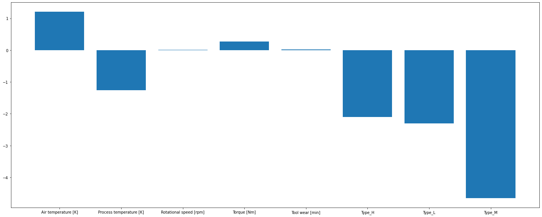
Results
Feature importance
Air Temperature (K)
Torque (Nm)

Slide 9
Conclusion
More room for improvement
I recommend adding data
Future uses
Improve maintenance pipelines
Test and improve new products

Slide 10
Questions?

